Slide 1







Slide 2
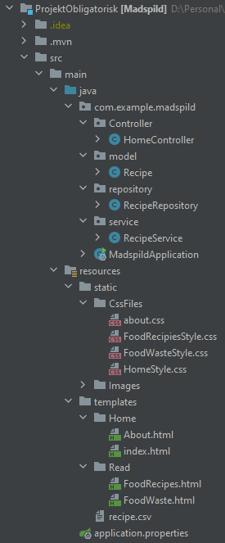
Scrum
Scrum
Scrum board (Trello)
Scrum master
User-stories
Daily Scrum
Product backlog
Sprint backlog
Sprint planning
Sprint review
Vores trello:
https://trello.com/b/8X7i6dby/obligatorisk1

Slide 3
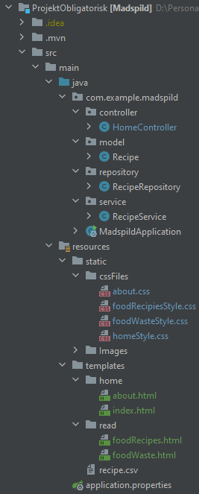
Intellij project structure
Layout
Hvordan har vi brugt packages til at fordele projektet?
package for orginasation hhv. controller, model, repository, service cssFiles, images, home, read
separation af file type i static
css for each page

Slide 4
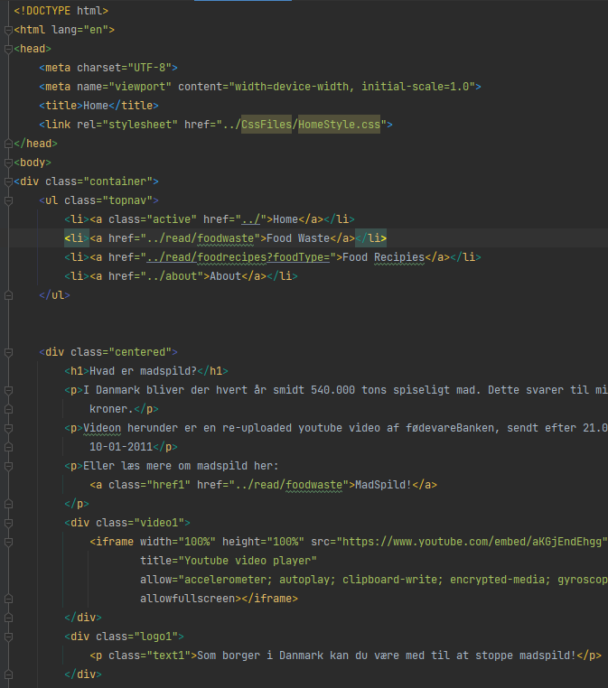
HTML & CSS
HTML
Vis strukturen af hjemmesiden på Intellij
CSS
Vis kode af CSS på Intellij

Slide 5
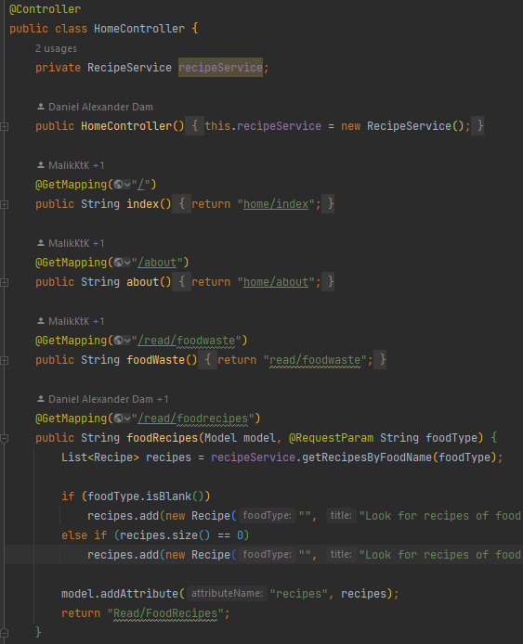

JAVA
Java i HTML
Food recipes
.csv file
Genbrug mad
Search bar

Slide 6

Showcase af hjemmeside
Showcase af hjemmeside
https://github.com/MalikKtK/ProjektObligatorisk
Navigation
Search bar

Slide 7
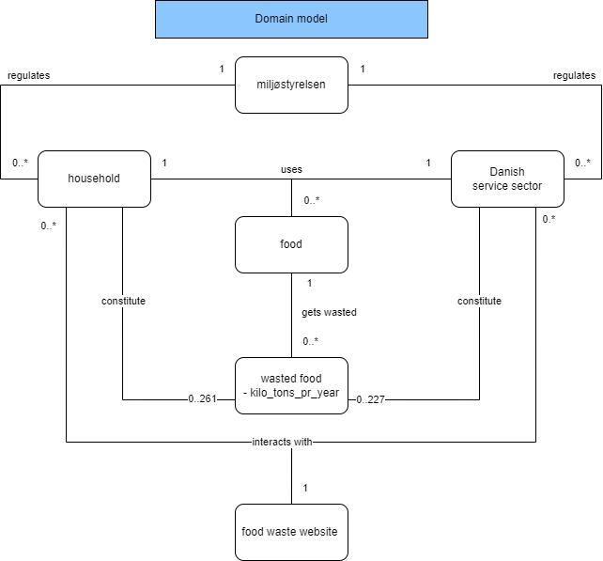
Domain model

Slide 8
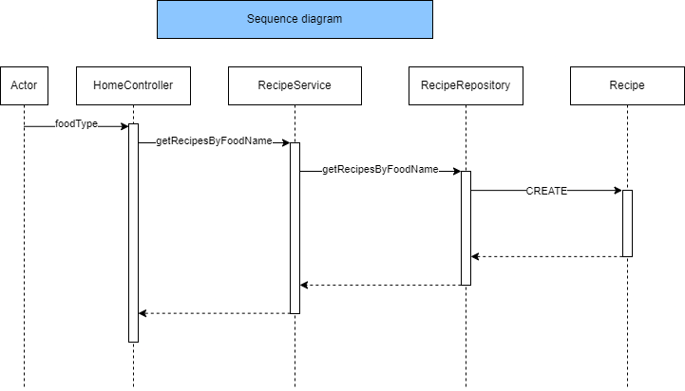
Sequence diagram over food selection

Slide 9
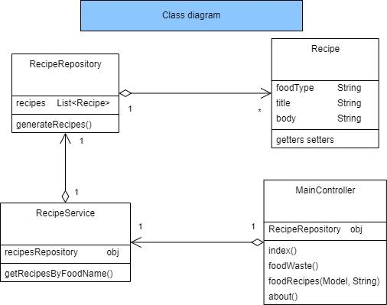
Class diagram

